Slide 1
IMAGE AND IMAGE COMPRESSION
Dr. Quang Duc Tran

Slide 2
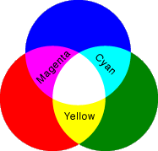
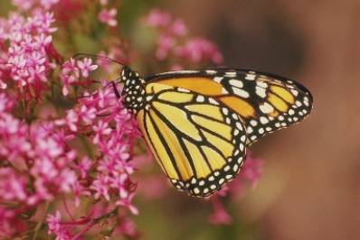
Image
All types of images are displayed in the form of a two-dimensional matrix of individual picture elements (pixels).
Pixel (RGB)

Slide 3
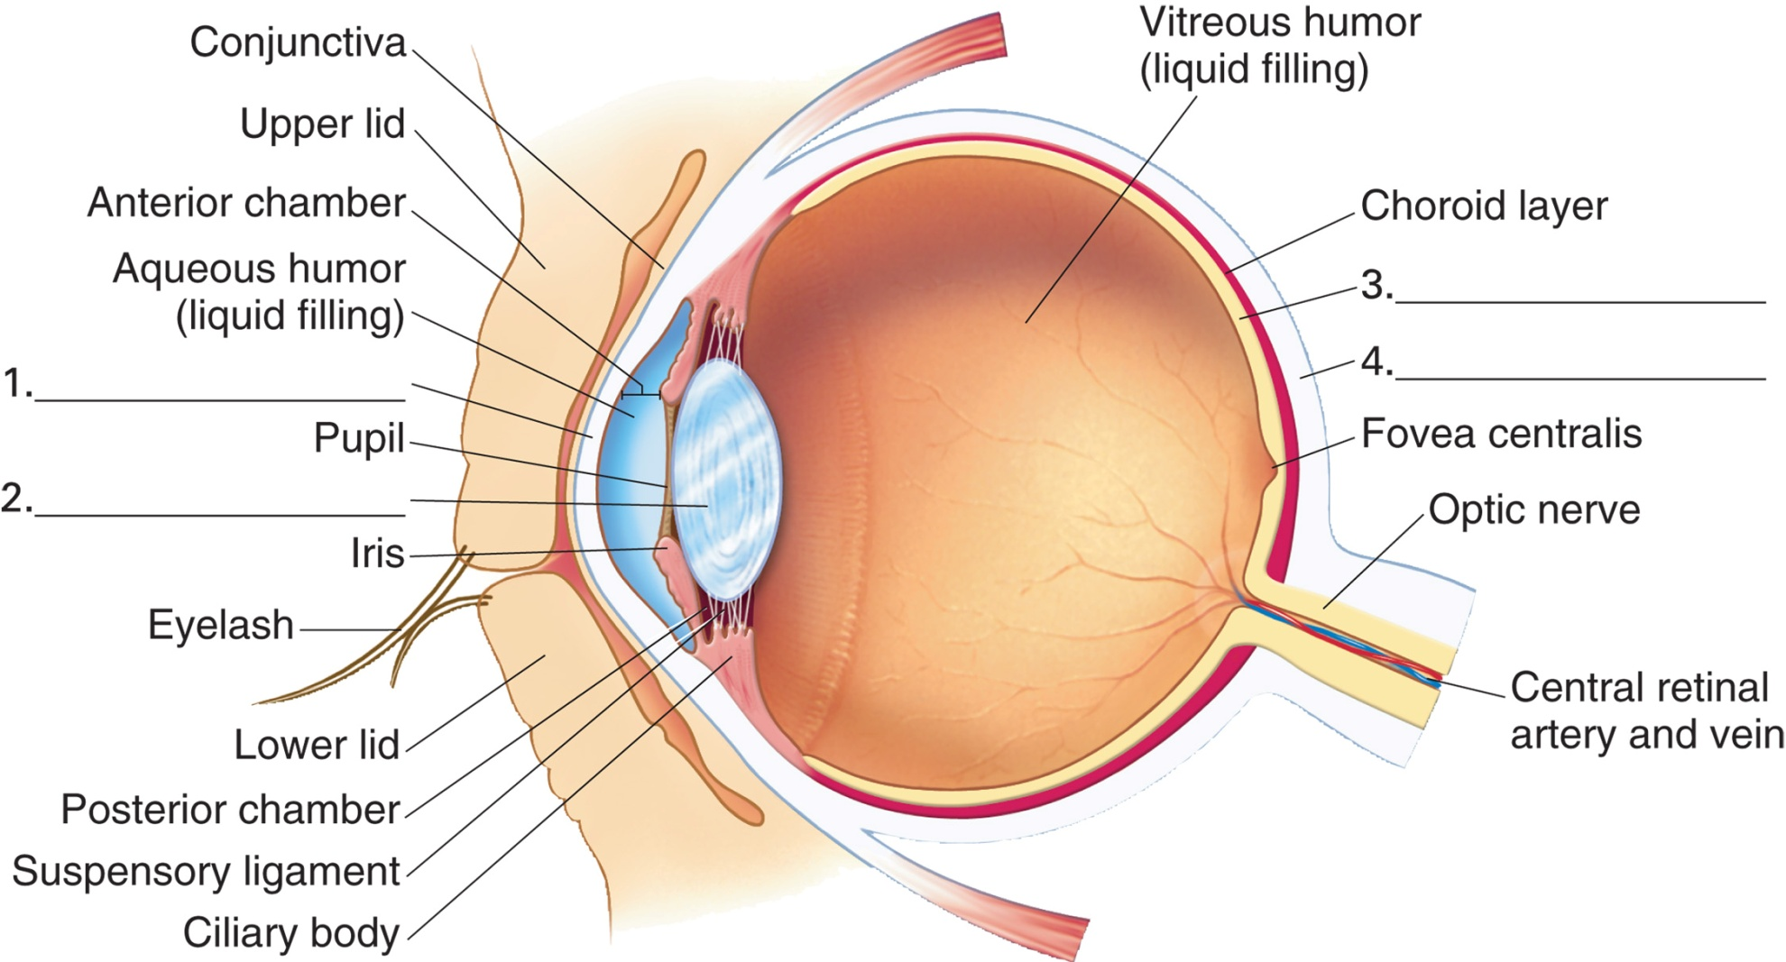
Structure of Human Eye
6 million cones and 120 million rods

Slide 4
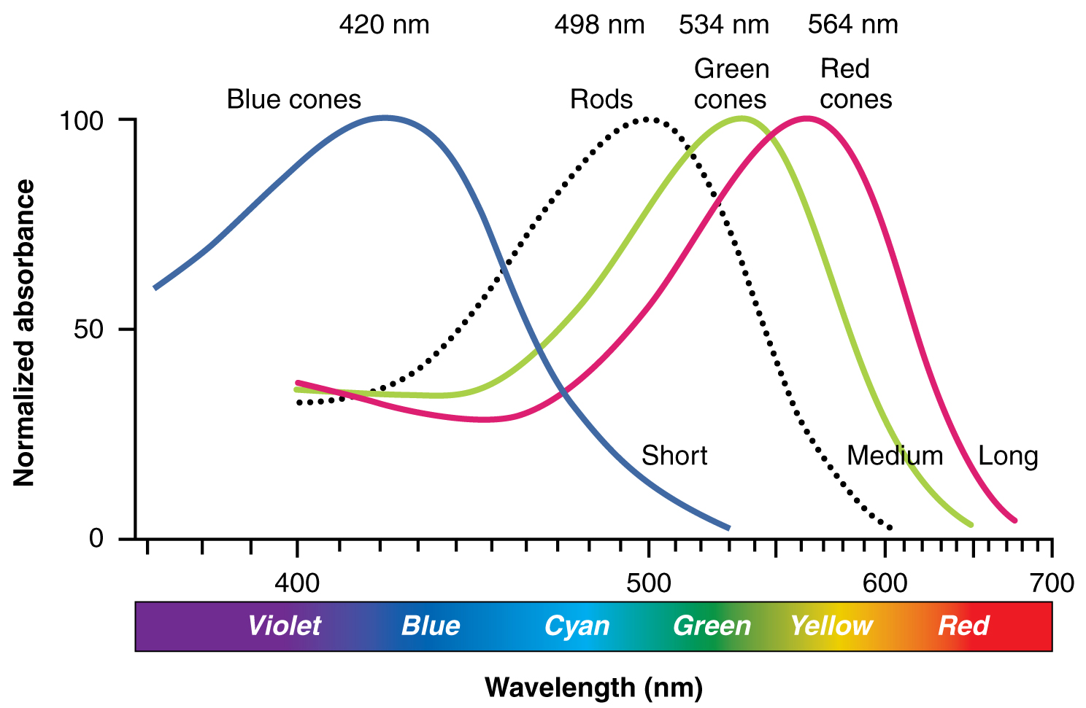
Structure of Human Eye

Slide 5
Color Models
RGB (Red, Green, and Blue) – Computer Monitors. RGBA is RGB with an additional channel, alpha, to indicate transparency.
CMYK (Cyan, Magenta, Yellow, and Black) – Photo printing.
YCbCr – Video capture system. YUV stores a luminance value along with two chroma values.
HSV – Artist. It is often more natural to think about color in terms of hue and saturation than additive and subtractive color components

Slide 6
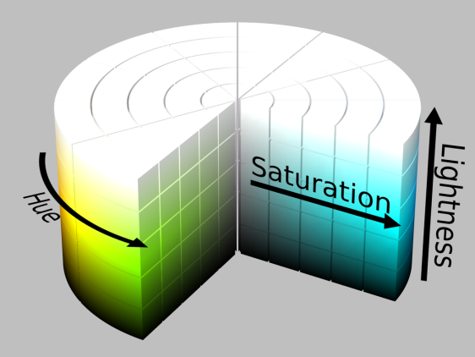
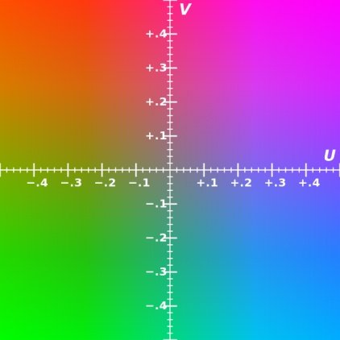
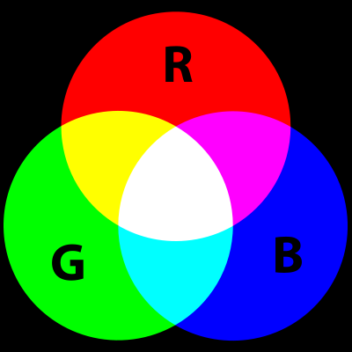
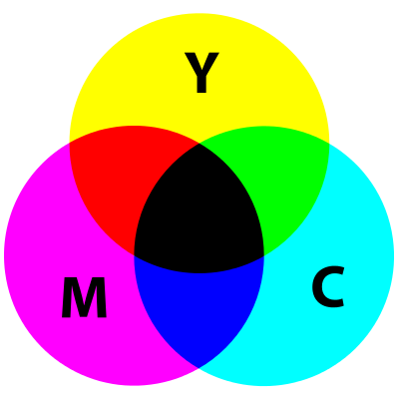
Color Models (Cont.)
HSV
YCbCr (Y=0.5)
RGB
CMYK

Slide 7
Color Models (Cont.)
YCbCr is not an absolute color space, it is a way of encoding RGB information. YCbCr contains perceptually meaningful information.
Y = 16+219(0.299R+0.587G+0.114B)/255
Cb = 128+224(-0.169R-0.331G+0.5B)/255
Cr = 128+224(0.5R-0.419G-0.081B)/255

Slide 8
Image Compression
Lossless Compression
Run-Length coding (RLC)
Huffman coding
Lempel-Ziv coding
Lossy compression
Transform coding
Chroma sub-sampling
JPEG

Slide 9
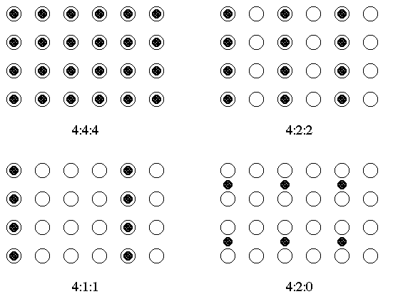
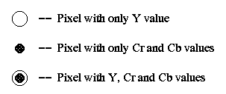
Chroma Sub-sampling

Slide 10
Chroma Sub-sampling (Cont.)
4:4:4 (1:1)
High end film scanners
Cinematic postproduction.
4:2:2 (3:2)
High end digital video formats and interfaces
4:1:1 (2:1)
DVCPRO (e.g., NTSC, PAL )
4:2:0 (2:1)
MPEG, H.26X video coding
DVD, Blue-ray Disc
JPEG, MJPEG

Slide 11
JPEG Standard
Dr. Quang Duc Tran

Slide 12
JPEG Standard
JPEG is an image compression standard that was developed by the “Joint Photographic Experts Group”.
JPEG is the most common format for storing and transmitting photographic images.
JPEG works with both color and grayscale images
The compression rate is typically 10:1 with little perceptible loss in image quality

Slide 13
JPEG Standard (Cont.)
JPEG is a lossy compression technique. It employs 2D-DCT (Discrete Cosine Transform) transform coding, whose effectiveness replies on 3 major observations:
Observation 1: Useful image contents change relatively slowly across the image.
Observation 2: Humans are much less likely to notice the loss of very high spatial frequency components than the loss of low frequency components.
Observation 3: Visual acuity (accuracy in distinguishing closely spaced lines) is much greater for gray than for color.

Slide 14
JPEG Coding
8×8 blocks
Entropy
Encoding
Compressed Image
FDCT
Quantization
Source Image
Quant. Table
Huffman Table
8×8 blocks
Entropy
Decoding
IDCT
Dequantization
Source Image
Quant. Table
Huffman Table

Slide 15
Energy Compaction
Energy Compaction means that a large proportion of the total signal energy is contained in a handful of high-valued coefficients. The larger coefficients are likely to have higher psychovisual significance than their low-valued counterparts and can be coded accordingly.
Energy compaction is important for image compression. In many practical situations, the image tend to have most of their energy in the lower frequencies.

Slide 16
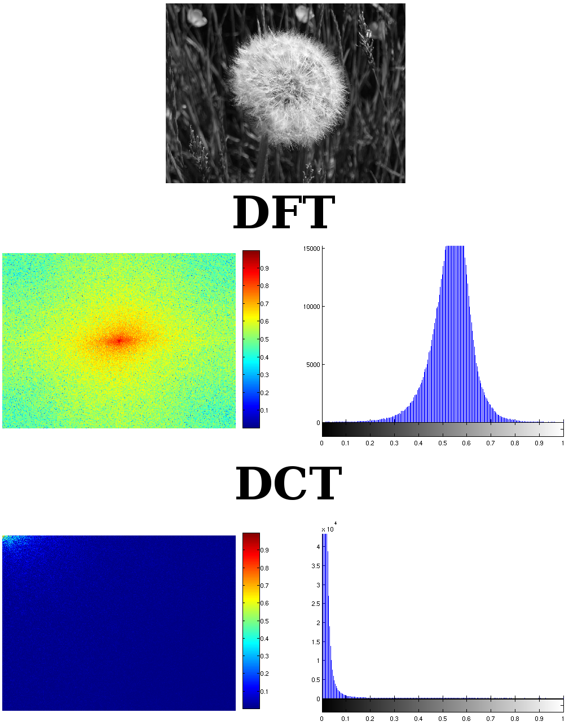
Fourier Transform
The Fourier transform is not actually optimal for image coding since the DCT can give a higher compression rate, for the same image quality.
DCT components are much more concentrated than those for the Fourier. DCT has been considered as optimal for image coding.
(a) FFT
(b) DCT

Slide 17
Principal Component Analysis
PCA is a statistical method that uses orthogonal transformation to turn a correlated set of data into a linearly uncorrelated set of data, which contain principal components.
PCA can be used to compress an image, it represents spatial information in an image in a more compact “energy-like” representation.
PCA is more efficient than the DCT, but it is far more computationally expensive.

Slide 18
Discrete Cosine Transform
DCT transforms a signal of image from the spatial domain to the frequency domain.
DCT is similar to the Fast Fourier Transform (FFT) but can approximate lines well with fewer coefficients.
For most images, much of the signal energy lies at low frequencies, which appear in the upper left corner of the DCT
Compression is achieved since the lower right values represent higher frequencies and are often small – small enough to be neglected with little visible distortion.

Slide 19
Discrete Cosine Transform

Slide 20
Discrete Cosine Transform (Cont.)
Both DC (i.e., F(0,0)) and AC (i.e., F(u,v) (u,v≠0)) coefficients contains integers, these can range from -1024 to 1023
52 | 55 | 61 | 66 | 70 | 61 | 64 | 73
63 | 59 | 55 | 90 | 109 | 85 | 69 | 72
62 | 59 | 68 | 113 | 144 | 104 | 66 | 73
63 | 58 | 71 | 122 | 154 | 106 | 70 | 69
67 | 61 | 68 | 104 | 126 | 88 | 68 | 70
79 | 65 | 60 | 70 | 77 | 68 | 58 | 75
85 | 71 | 64 | 59 | 55 | 61 | 65 | 83
87 | 79 | 69 | 68 | 65 | 76 | 78 | 94
415 | -30 | -61 | 27 | 56 | -20 | -2 | 0
4 | -22 | -61 | 10 | 13 | -7 | -9 | 5
--47 | 7 | 77 | -25 | -29 | 10 | 5 | -6
-49 | 12 | 34 | -15 | -10 | 6 | 2 | 2
12 | -7 | -13 | -4 | -2 | 2 | -3 | 3
-8 | 3 | 2 | -6 | -2 | 1 | 4 | 2
-1 | 0 | 0 | -2 | -1 | -3 | 4 | -1
0 | 0 | -1 | -4 | -1 | 0 | 1 | 2
DCT

Slide 21
Quantization
Quantization discards information, which is not visually significant. It is fundamentally lossy and is the principal source of lossiness in DCT-based encoders.
Quantization step size should be chosen as a perceptual threshold, which is a function of the source image characteristic, display characteristic and viewing distance.
For a particular application, the best thresholds should be determined by performing psycho-visual experiments.
F^{Q}(u,v)=Integer Round (F (u,v)/Q(u,v))
Quantization step size

Slide 22
Quantization (Cont.)
It is typically the case that many of the higher frequency components are rounded to zero, and many of the rest become small positive or negative numbers, which take many fewer bits to represent.
16 | 11 | 10 | 16 | 24 | 40 | 51 | 61
12 | 12 | 14 | 19 | 26 | 58 | 60 | 55
14 | 13 | 16 | 24 | 40 | 57 | 69 | 56
14 | 17 | 22 | 29 | 51 | 87 | 80 | 62
18 | 22 | 37 | 56 | 68 | 109 | 103 | 77
24 | 35 | 55 | 64 | 81 | 104 | 113 | 92
49 | 64 | 78 | 87 | 103 | 121 | 120 | 101
72 | 92 | 95 | 98 | 112 | 100 | 103 | 99
26 | -3 | -6 | 2 | 2 | -1 | 0 | 0
0 | -2 | -4 | 1 | 1 | 0 | 0 | 0
-3 | 1 | 5 | -1 | -1 | 0 | 0 | 0
-4 | 1 | 2 | -1 | 0 | 0 | 0 | 0
1 | 0 | 0 | 0 | 0 | 0 | 0 | 0
0 | 0 | 0 | 0 | 0 | 0 | 0 | 0
0 | 0 | 0 | 0 | 0 | 0 | 0 | 0
0 | 0 | 0 | 0 | 0 | 0 | 0 | 0

Slide 23
Entropy Encoding
Entropy encoding is a special form of lossless data compression.
Entropy encoding involves arranging the image components in a zigzag order employing Run Length Coding (RLC) algorithm, inserting length coding zeros, and then using Huffman coding on what is left.
DC
DPCM
Huffman coding
F^{Q}(u,v)
01101…
AC
RLC

Slide 24
Zigzag Order
All of the quantized coefficients are ordered into the zigzag sequence. It places low frequency coefficients (which are more likely to be non-zero) before high-frequency coefficients.
26 | -3 | -6 | 2 | 2 | -1 | 0 | 0
0 | -2 | -4 | 1 | 1 | 0 | 0 | 0
-3 | 1 | 5 | -1 | -1 | 0 | 0 | 0
-4 | 1 | 2 | -1 | 0 | 0 | 0 | 0
1 | 0 | 0 | 0 | 0 | 0 | 0 | 0
0 | 0 | 0 | 0 | 0 | 0 | 0 | 0
0 | 0 | 0 | 0 | 0 | 0 | 0 | 0
0 | 0 | 0 | 0 | 0 | 0 | 0 | 0
26 | -3 | -6 | 2 | 2 | -1 | 0 | 0
0 | -2 | -4 | 1 | 1 | 0 | 0 | 0
-3 | 1 | 5 | -1 | -1 | 0 | 0 | 0
-4 | 1 | 2 | -1 | 0 | 0 | 0 | 0
1 | 0 | 0 | 0 | 0 | 0 | 0 | 0
0 | 0 | 0 | 0 | 0 | 0 | 0 | 0
0 | 0 | 0 | 0 | 0 | 0 | 0 | 0
0 | 0 | 0 | 0 | 0 | 0 | 0 | 0

Slide 25
DPCM & RLC
There are strong correlation between DC coefficients of adjacent blocks. Hence, the quantized DC is encoded as the difference from the DC term of the previous block in the encoding order by using DPCM.
RLC is applied to encode other AC coefficients
DC_{i-1}
DC_{i}
DIFF = DC_{i} - DC_{i-1}

Slide 26
DPCM & RLC (Cont.)
DC coefficient: +3 → (2),(3)
AC coefficients:
(0,2) (-3)
(1,2) (-3)
(0,2) (-2)
(0,3) (-6)
(0,2) (2)
…
(0,0) → EOB
AC coefficient is made up of a pair of symbols (run length, size) (amplitude). Run length is the number of zeros in the run. Size is the number of bits used to encode amplitude.
-26 | -3 | -6 | 2 | 2 | -1 | 0 | 0
0 | -2 | -4 | 1 | 1 | 0 | 0 | 0
-3 | 1 | 5 | -1 | -1 | 0 | 0 | 0
-4 | 1 | 2 | -1 | 0 | 0 | 0 | 0
1 | 0 | 0 | 0 | 0 | 0 | 0 | 0
0 | 0 | 0 | 0 | 0 | 0 | 0 | 0
0 | 0 | 0 | 0 | 0 | 0 | 0 | 0
0 | 0 | 0 | 0 | 0 | 0 | 0 | 0

Slide 27
Huffman Coding
Significant levels of compression can be obtained by replacing long string of a binary digit by a string of much shorter codeword.
The length of each codeword is a function of its relative frequency of occurrence.
JPEG provides general purpose Huffman tables, encoders may also choose to generate Huffman tables optimized for the actual frequency distributions in images being encoded.

Slide 28
Huffman Coding (Cont.)
Category | Values | Bits for the value
1 | -1,1 | 0,1
2 | -3,-2,2,3 | 00,01,10,11
3 | -7,-6,-5,-4,4,5,6,7 | 000,001,010,011,100,101,110,111
4 | -15,...,-8,8,...,15 | 0000,...,0111,1000,...,1111
5 | -31,...,-16,16,...31 | 00000,...,01111,10000,...,11111
6 | -63,...,-32,32,...63 | 000000,...,011111,100000,...,111111
7 | -127,...,-64,64,...,127 | 0000000,...,0111111,1000000,...,1111111
8 | -255,..,-128,128,..,255 | ...
9 | -511,..,-256,256,..,511 | ...
10 | -1023,..,-512,512,..,1023 | ...
11 | -2047,..,-1024,1024,..,2047 | ...
Values and bits for values

Slide 29
Huffman Coding (Cont.)
Run, category | Code Length | Codeword
0,0 | 4 | 1010
0,1 | 2 | 00
0,2 | 2 | 01
... | … | …
0,10 | 16 | 1111111110000011
1,1 | 4 | 1100
1,2 | 5 | 11011
… | … | …
15,10 | 16 | 1111111111111110
Luminance AC coefficients

Slide 30
Huffman Coding (Cont.)
Category | Code Length | Codeword
0 | 2 | 00
1 | 3 | 010
2 | 3 | 011
3 | 3 | 100
4 | 3 | 101
5 | 3 | 110
6 | 4 | 1110
7 | 5 | 11110
8 | 6 | 111110
9 | 7 | 1111110
10 | 8 | 11111110
11 | 9 | 111111110
Luminance DC coefficients

Slide 31
Huffman Coding (Cont.)
DC coefficient: +3 → (2),(3)
Encoded DC coefficient: 011 11
AC coefficients: (0,2) (-3), (1,2) (-3)… EOB
Encoded AC coefficient: 01 00 11011 00 … 00

Slide 32
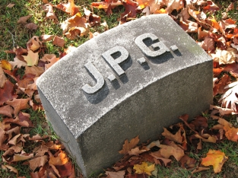



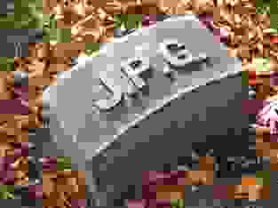
Example
1
2
3
Q = 100 - 83,2 bytes
Q = 50 - 15,1 bytes
Q = 25 - 9,5 bytes
Q = 10 - 4,7 bytes
Q = 5 - 1,5 bytes
4
5

Slide 33
Why another standard?
At low bit-rates (e.g., 0.25 bpp), the distortion in JPEG becomes unacceptable.
JPEG has 44 modes, many of them are not used by the majority of the JPEG encoders.
JPEG quality suffers dramatically, when bit errors are encountered during transmission.
JPEG is optimized for natural images and performs badly on graphics.
JPEG fails to compress bi-level (text) imagery.

Slide 34
JPEG2000 Standard
Dr. Quang Duc Tran

Slide 35
Key Features
Wavelet transform
Superior low bit-rate performance
Bi-level compression
Lossy and lossless compression
Robustness to bit errors
Scalability
Region of Interest

Slide 36
Operation Flow
Cut the image into non-overlapping tiles of equal size
Perform a component transformation
Process each tile of each component separately
Discrete Wavelet Transform
Quantization
EBCOT: Embedded Block Coding with Optimal Truncation
Comp. & Tile
DWT
Quantization
EBCOT
Image
1010….

Slide 37
Discrete Wavelet Transform
The signal x(n) is decomposed through a low and a high pass analysis filter, and subsample the filtering result by a factor of 2.
To reconstruct the original signal, a low and high pass coefficients are up-sampled by a factor of 2 and pass through another low and high pass synthesis filter pair.
Low-pass Analysis
2
2
Low-pass Synthesis
x(n)
x’(n)
High-pass Analysis
2
2
High-pass Synthesis

Slide 38
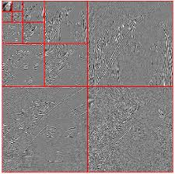
Discrete Wavelet Transform (Cont.)
To apply wavelet transformation to a 2D array, such as an image, it is common practice to apply the wavelet transform in the horizontal and vertical direction separately.
2LL
2HL
1HL
2LH
2HH
1LH
1HH

Slide 39
Quantization
Quantization is performed to uniformly quantize all wavelet coefficients. This converts the wavelet coefficients from floating number into integer number.
The image coding quality is not determined by the quantization step size δ, but in the subsequent bit stream assembler. The value of δ is rather fine, e.g., δ =1/128.
Quantization result
Transform coefficient
Quantization step size

Slide 40
Quantization (Cont.)
The quantized coefficients are partition into packets. Each sub-band is divided into non-overlapping rectangles of equal size. Three rectangles correspond to the same space location at the three directional sub-bands HL, LH, HH of each resolution level comprise a packet.
The packet partition contains information needed for decoding image of a certain spatial region at a certain resolution.
The packet are further divided into non-overlapping code-blocks, i.e., fundamental entities of entropy coding.

Slide 41
Quantization (Cont.)
2HL
2LH
2HH
1
2
3
4
Dead zone
5
6
9
10
7
8
11
12
The default size of a code-block is 64x64
Small coefficients increase the quality of the image the least. A dead zone quantizer discards these coefficients

Slide 42
EBCOT
The packet partition contains information needed for decoding image of a certain spatial region at a certain resolution.
The packet are further divided into non-overlapping code-blocks, i.e., fundamental entities of EBCOT.
EBCOT is conceptually divided into two layers, called Tiers.
Tier 1 involves source modeling and entropy coding.
Tier 2 generates the output bit stream.

Slide 43
EBCOT (Cont.)
Code-block are coded by bit-plane, i.e., coefficient bits of the same order are coded together.
The most significant bits are coded first, then low order bits are coded in descending order.
Each bit-plane is coded independently. Bit-plane is further partitioned into three coding passes, i.e., significance propagation, magnitude refinement, and clean-up passes.
Each coding pass constitutes a code unit, called chunk.

Slide 44
EBCOT (Cont.)
b1 | b2 | b3 | b4 | b5 | b6 | b7 | S
0 | 1 | 0 | 1 | 1 | 0 | 1 | +
1 | 0 | 0 | 1 | 0 | 1 | 0 | -
0 | 0 | 1 | 0 | 1 | 0 | 1 | +
0 | 0 | 0 | 1 | 1 | 1 | 0 | +
0 | 0 | 0 | 0 | 1 | 0 | 0 | -
0 | 0 | 1 | 0 | 0 | 1 | 0 | -
0 | 0 | 0 | 0 | 1 | 0 | 0 | +
0 | 0 | 0 | 0 | 0 | 0 | 1 | -
45 | 0 | 0 | 0 | 0 | 0 | 0 | 0
-74 | -13 | 0 | 0 | 3 | 0 | 4 | 0
21 | 0 | 4 | 0 | 0 | 3 | 5 | 0
14 | 0 | 23 | 23 | 0 | 0 | 0 | 0
-4 | 5 | 0 | 0 | 0 | 1 | -1 | 0
-18 | 0 | 0 | 19 | -4 | 33 | 0 | -1
4 | 0 | 23 | 0 | 0 | 0 | 1 | 0
1 | 0 | 0 | 0 | 0 | 0 | 0 | 0
MSB
LSB

Slide 45
EBCOT (Cont.)
Chunks constitute valid truncation points.
Both encoder and decoder can truncate the bit stream in correspondence of a valid truncation point in order to recover the original data up to a target quality.
The output bit stream is made up by a number of packets containing chunks of the code-blocks in a given sub-band and belonging to the same layer.
Since packet header information is highly redundant, it is also compressed to reduce the packet overhead.

Slide 46
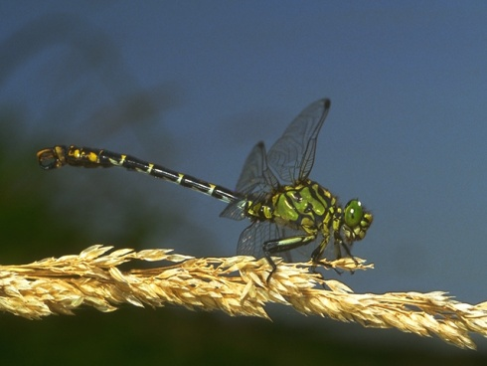



JPEG2000 Features
Lossless
5.2 bpp
Lossy
bit stream
Original image
Lower resolution
ROI
1.89 bpp

Slide 47
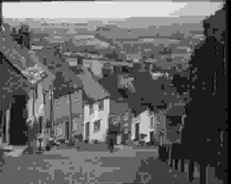
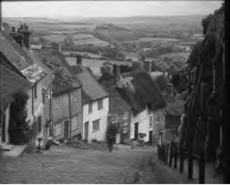
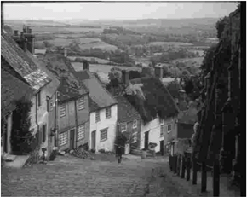
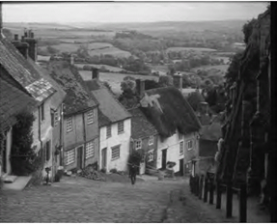
JPEG vs. JPEG2000
0.125 bpp
JPEG vs. JPEG2000
0.25 bpp

